Slide 1
Design and Analysis of Algorithms
Algorithms-II : CS345A
Lecture 19
Shortest paths
in presence of negative weights

Slide 2
Shortest pathS in a graph
In presence of negative edge weights

Slide 3
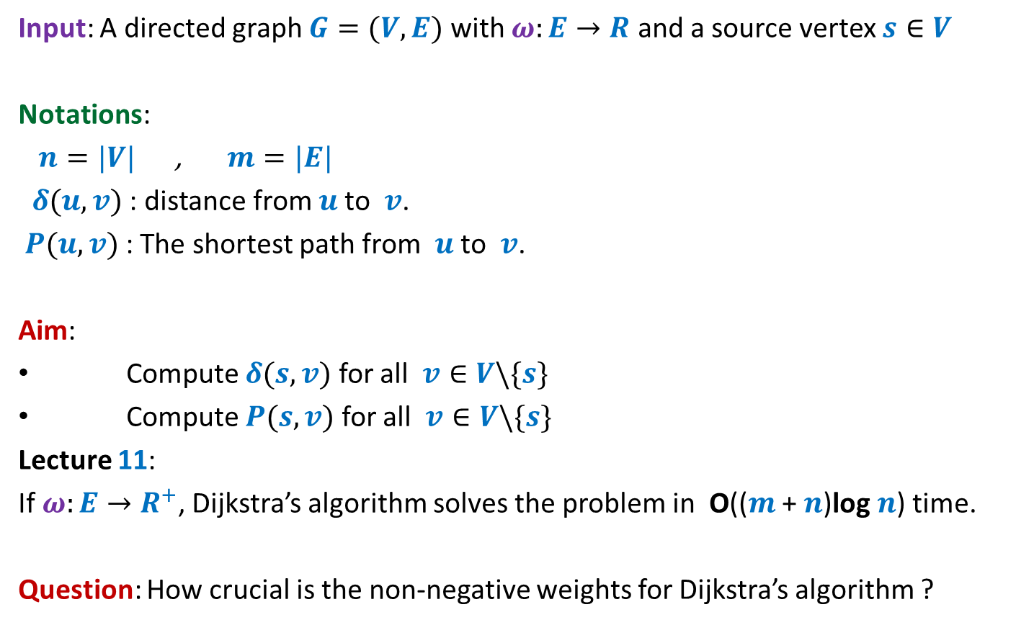
Problem Definition
Input: A directed graph $G=(V,E)$ with $ω:E→R$ and a source vertex $s∈V$
Notations:
$n=|V|$ , $m=|E|$
$δ(u,v)$ : distance from $u$to $v$.
$P(u,v)$ : The shortest path from $u$to $v$.
Aim:
Compute $δ(s,v)$ for all $v∈V\backslash \{s\}$
Compute $P(s,v)$ for all $v∈V\backslash \{s\}$
Lecture 11:
If $ω:E→R^{+}$, Dijkstra’s algorithm solves the problem in O(($m$ + $n$)log $n$) time.
Question: How crucial is the non-negative weights for Dijkstra’s algorithm ?

Slide 4
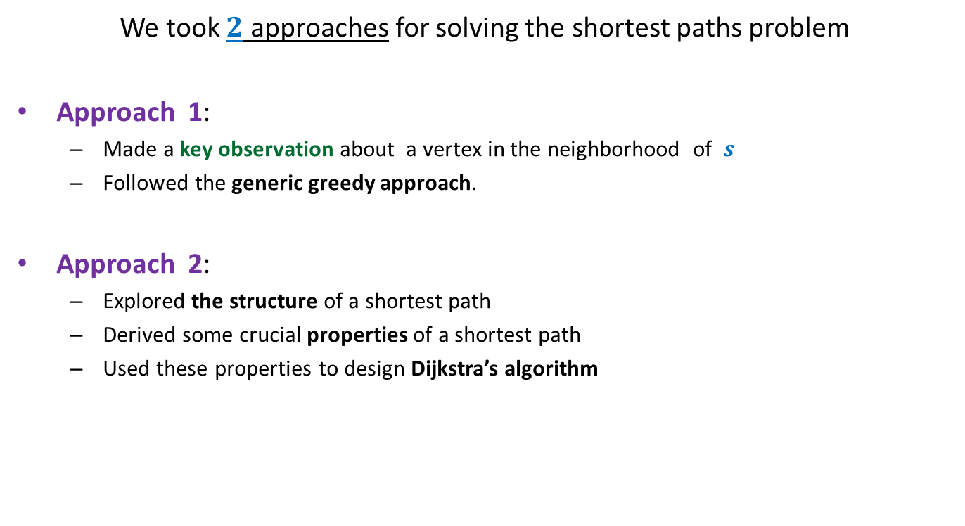
Revisiting Lecture 11
We took $2$ approaches for solving the shortest paths problem
Approach 1:
Made a key observation about a vertex in the neighborhood of $s$
Followed the generic greedy approach.
Approach 2:
Explored the structure of a shortest path
Derived some crucial properties of a shortest path
Used these properties to design Dijkstra’s algorithm
Let us explore how crucial was the role of “non-negative edge weights” in these approaches.

Slide 5












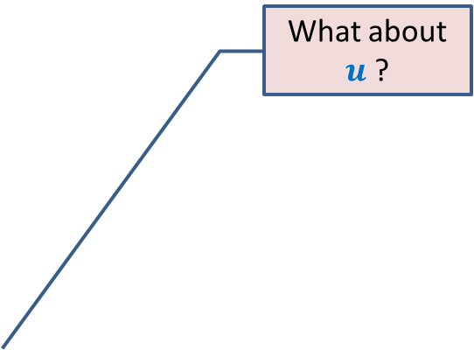
Approach 1
What about $u$ ?
Question: Can we be certain about the distance from $s$ to any vertex in this picture ?
Answer: NO.☹
$$z$$
$$10$$
$$v$$
G
$$12$$
$$7$$
$$x$$
$$s$$
$$−3$$
$$5$$
$$u$$
$$y$$

Slide 6

Approach 1
$$z$$
$$10$$
$$v$$
G
$$12$$
$$7$$
$$x$$
$$s$$
$$−3$$
$$5$$
$$u$$
$$y$$
$$−16$$
Approach 1 fails ☹

Slide 7
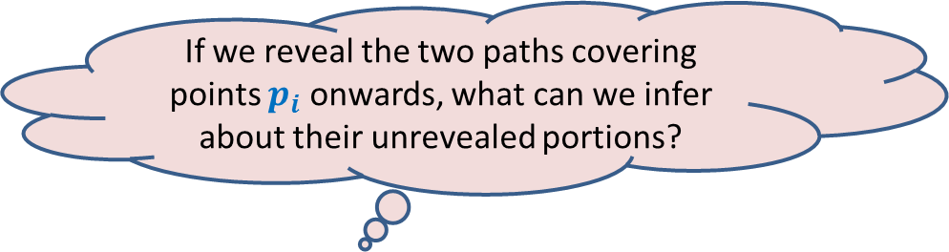
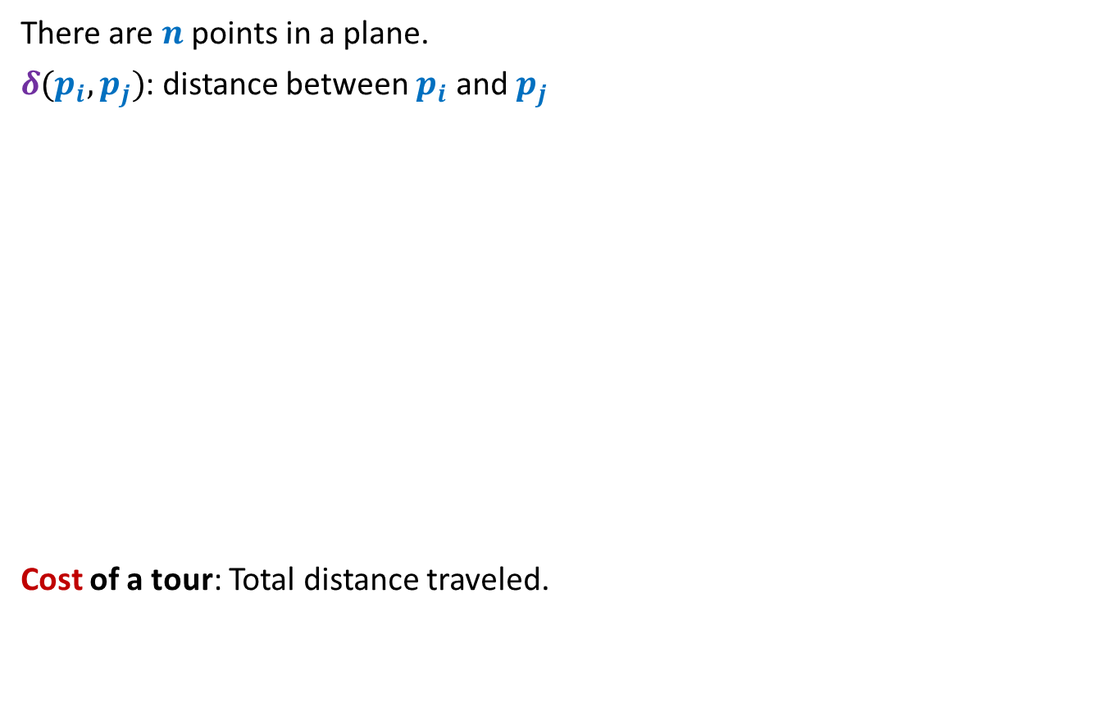


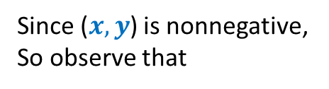




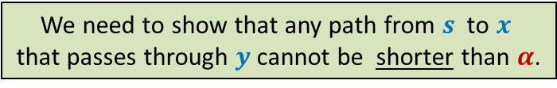
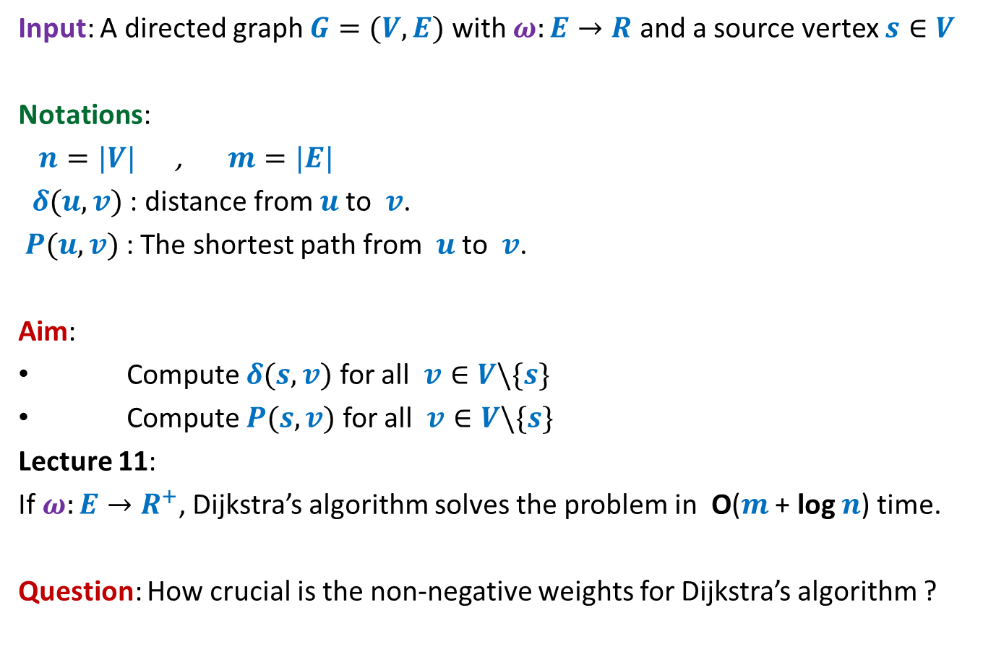



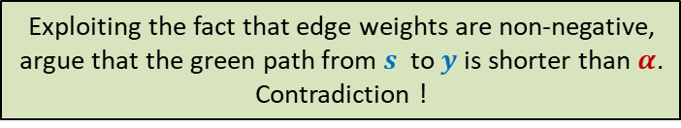
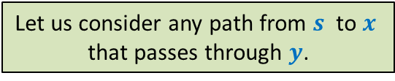
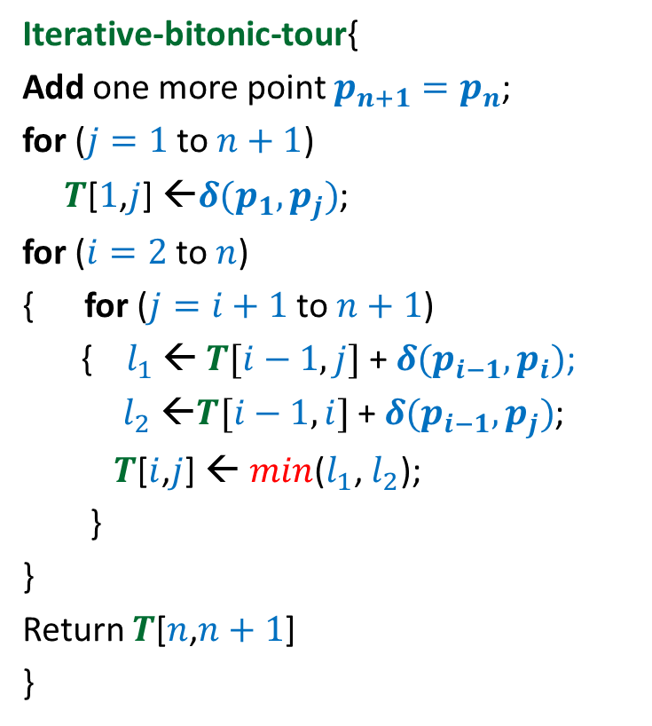

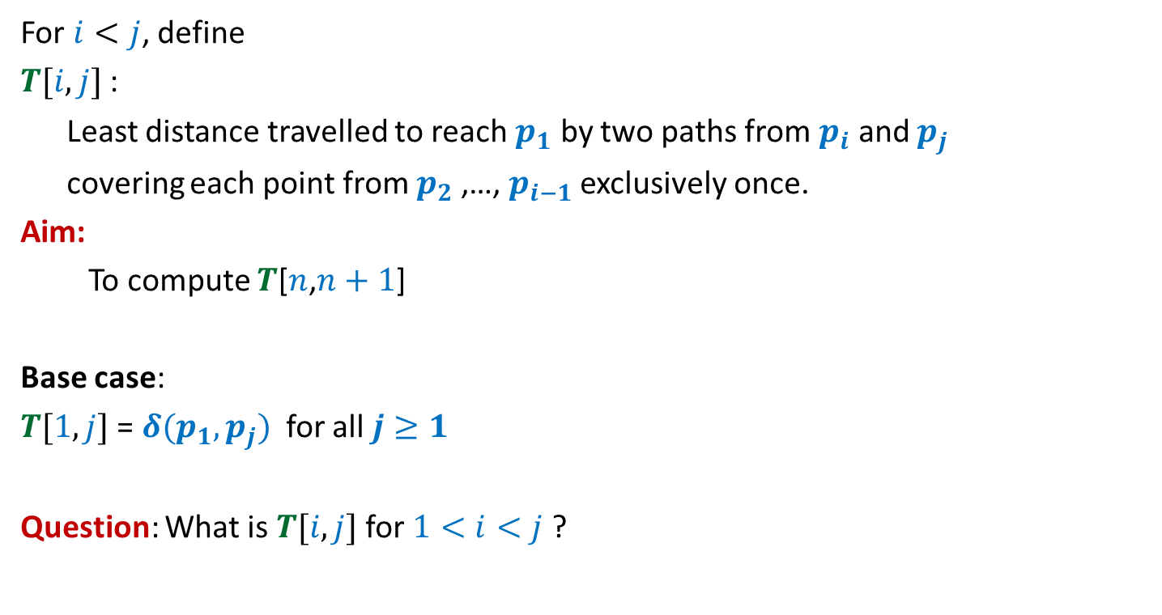



What properties does Dijkstra’s algorithm exploit ?
Approach 2
Property 1: Any subpath of $P(s,y)$ is also a shortest path.
Proof: If $Q$ is not shortest path to $x$,
replace it by a shorter path from $s$ to $x$.
This will give us a path to $y$, which is shorter than $P(s,y)$.
This contradicts that $P(s,y)$ is the shortest path to $y$.
If $P\left(s,y\right)=Q∷(x,y)$, then $Q$ is the shortest path from $s$ to $x$.
Suppose this path is shorter than $α$
$$<α$$
$$a$$
$$b$$
$$c$$
$$f$$
$$<α$$
Since ($x,y$) is nonnegative,
So observe that
We used 2 properties of a shortest path to design Dijkstra’s algorithm
$$P(s,y)$$
$$δ\left(s,y\right)≥α$$
$$s$$
$$u$$
$$v$$
$$x$$
$$y$$
$α$= Length of $Q$
$$Q$$
This proof is incomplete.
Can you spot that ?
What if there is a shorter path to $x$ that passes through $y$ ?
Let us consider any path from $s$ to $x$
that passes through $y$.
Exploiting the fact that edge weights are non-negative,
argue that the green path from $s$ to $y$is shorter than $α$.
Contradiction !
We need to show that any path from $s$ to $x$
that passes through $y$cannot be shorter than $α$.
The argument of the proof won’t work.
What to do ? ☹

Slide 8

What properties does Dijkstra’s algorithm exploit ?
?
Property 1: Any subpath of $P(s,y)$ is also a shortest path.
Property 2:
$δ\left(s,u\right)≤δ\left(s,v\right)≤δ(s,x)≤δ(s,y)$
If $P\left(s,y\right)=Q∷(x,y)$, then $Q$ is the shortest path from $s$ to $x$.
$$P(s,y)$$
$$s$$
70
$$u$$
-20
$$v$$
10
$$x$$
-55
$$y$$
Which of these properties will fail to hold if edge weights are allowed to be negative ?

Slide 9

Violating the Optimal subpath property
Property 1: Any subpath of $P(s,y)$ is also a shortest path.
$δ(s,y)$ = ?
$δ(s,x)$ = ?
To show the violation, we need to come up with
a path to $x$ of length < 60 that passes through $y$.
and still keeping $δ(s,y)$ = 5.
If $P\left(s,y\right)=Q∷(x,y)$, then $Q$ is the shortest path from $s$ to $x$.
5
2
-3
10
40
$$a$$
$$b$$
$$c$$
$$f$$
5
6
$$P(s,y)$$
$$s$$
70
$$u$$
-20
$$v$$
10
$$x$$
-55
$$y$$
60
< 30
10

Slide 10

Violating the Optimal subpath property
Property 1: Any subpath of $P(s,y)$ is also a shortest path.
$δ(s,y)$ = ?
$δ(s,x)$ = ?
If $P\left(s,y\right)=Q∷(x,y)$, then $Q$ is the shortest path from $s$ to $x$.
5
2
-3
10
40
$$a$$
$$b$$
$$c$$
$$f$$
5
6
$$P(s,y)$$
$$s$$
70
$$u$$
-20
$$v$$
10
$$x$$
-55
$$y$$
What to do ? ☹
10
This example illustrates that the optimal subpath property may get violated when the edge weights are negative.
Instead of working with these numbers (2,-3,10,…), consider a generic example where the property fails.
Start all over from scratch to solve the shortest paths problem in graph with –ve edge weights
But how ?
Let us investigate like a true researcher for the exact cause of the violation of the optimal subpath property.
Give up !

Slide 11


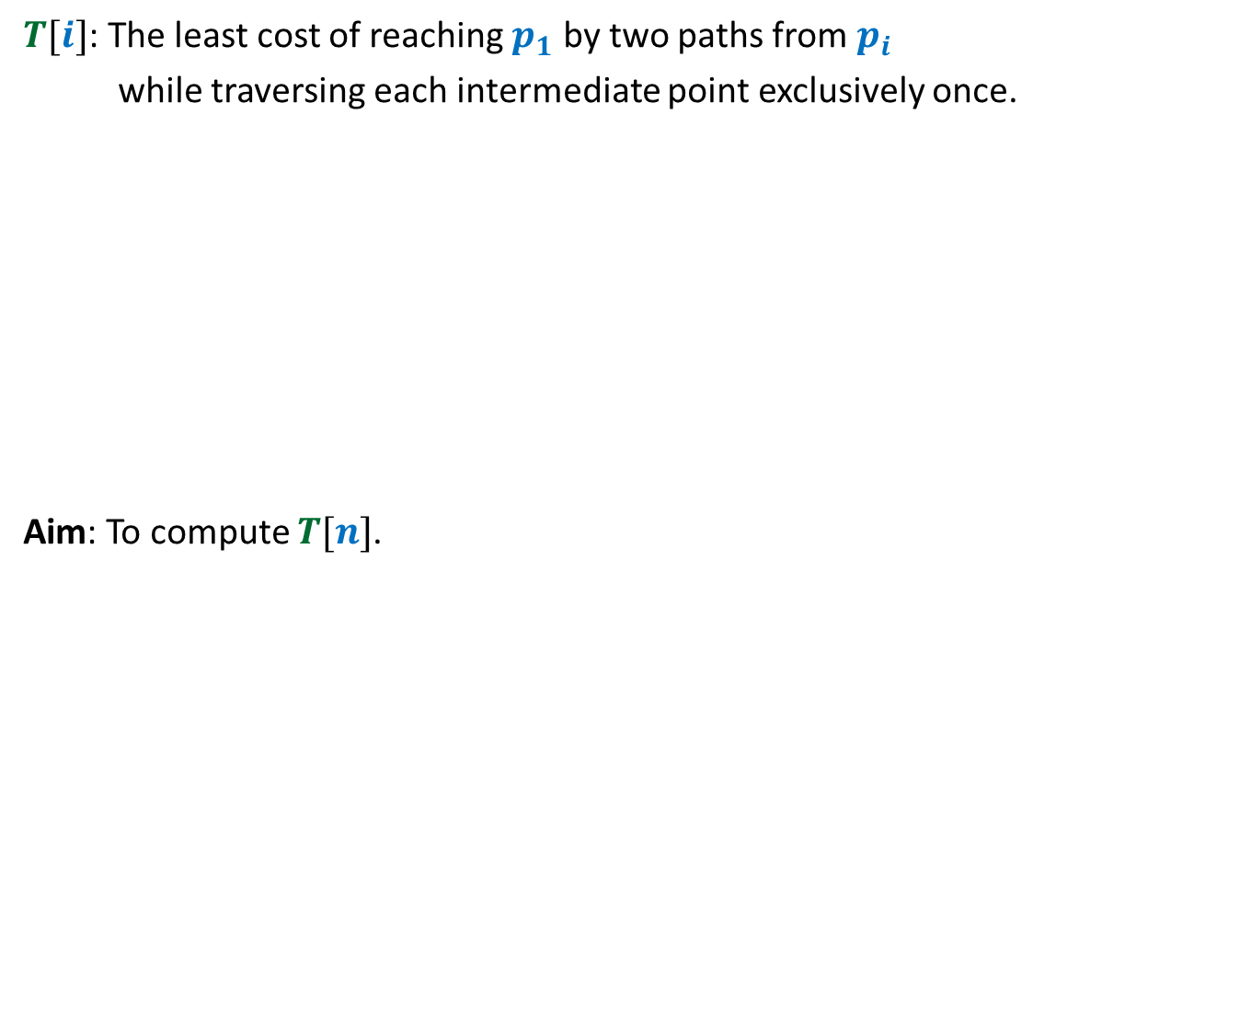




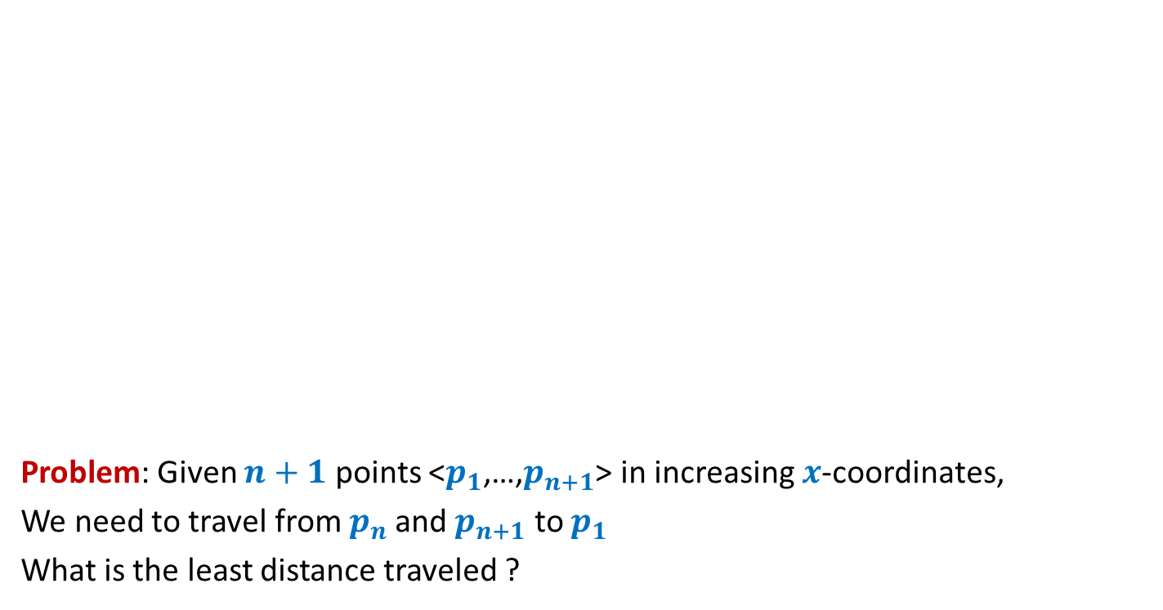
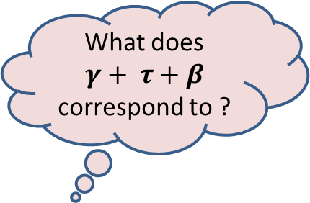

Violating the Optimal subpath property
What does $γ+ τ+β$ correspond to ?
$$C$$
Question: When can there be a shorter $s⇝x$ path pass through $y$ ?
$C+τ+β<α+β$
$α+β+γ+τ+β<α+β$
$$P(s,y)$$
$$s$$
$$α$$
$$β$$
$$x$$
$$γ$$
$$y$$
$$τ$$
$$α+β+γ≤C$$
Because $P(s,y)$ is the shortest path
Since the green path to $x$ is shorter than the subpath of $P(s,y)$
➔ $γ+ τ+β<0$

Slide 12


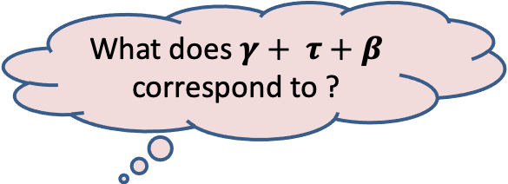
Violating the Optimal subpath property
What does $γ+ τ+β$ correspond to ?
$$C$$
Question: When can there be a shorter $s⇝x$ path pass through $y$ ?
Answer: Weight of the cycle $C$ must be NEGATIVE.
$$P(s,y)$$
$$s$$
$$α$$
$$β$$
$$x$$
$$γ$$
$$y$$
Cycle $C$
$$τ$$
➔ $γ+ τ+β<0$

Slide 13

Theorem: Given a directed $G=(V,E)$ with $ω:E→$ $R$,
if there are no negative cycles,
all shortest paths in $G$possess optimal substructure property
The spirit of a researcher proved to be very right.

Slide 14
shortest paths in a graph
Negative weights
BUT No negative cycle

Slide 15









Exploiting the Optimal subpath property
Observation: If $P(s,v)$ has $i$ edges, $P(s,x)$ has $i−1$ edges.
$$P(s,v)$$
$$1$$
$$2$$
$$…$$
$$i$$
$$s$$
$$x$$
$v$
Can you exploit this observation to design recursive formulation of the solution ?

Slide 16


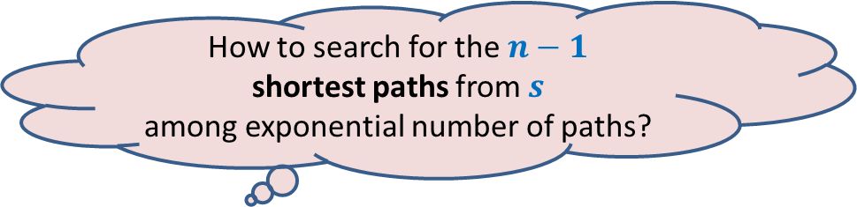
The brilliant idea of Bellman Ford
All paths from $s$
How to search for the $n−1$
shortest paths from $s$
among exponential number of paths?

Slide 17










The brilliant idea of Bellman Ford
Recursive Formulation for $L\left(v,i\right)$
Aim:
To compute $L(v,n−1)$ for all $v$
$$n−1$$
$P(v,i)$ : the shortest $s⇝v$ path having at most $i$ edges.
$L(v,i)$ : length of $P(v,i)$
$$n−2$$
$$i$$
$$i−1$$
$$1$$
Paths with edges $≤i$
All paths from $s$
Paths with edges$≤i−1$

Slide 18

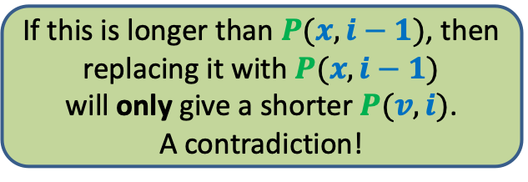




The brilliant idea of Bellman Ford
Recursive Formulation for $L\left(v,i\right)$
Case 1: $P(v,i)$ has $<i$ edges $L(v,i)$ = $L(v, i−1)$
Case 2: $P(v,i)$ has exactly $i$ edges
There are $2$ cases for $P(v,i)$. Can you spot them ?
$$i$$
$$i−1$$
$$1$$
Paths with edges $≤i$
If this is longer than $P(x,i−1)$, then
replacing it with $P(x,i−1)$
will only give a shorter $P(v,i)$.
A contradiction!
Paths with edges$≤i−1$
?
$$P(x,i−1)$$
$$1$$
$$2$$
$$…$$
$$i$$
$$s$$
$$x$$
$v$

Slide 19




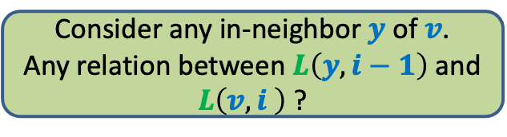
The brilliant idea of Bellman Ford
Recursive Formulation for $L\left(v,i\right)$
Case 1: $P(v,i)$ has $<i$ edges $L(v,i)$ = $L(v, i−1)$
Case 2: $P(v,i)$ has exactly $i$ edges
$L(v,i)$ = $\min_{\left((x,v\right)∈E)}\left(L\left(x, i−1\right)\text{+} ω\left(x,v\right)\right)$
But we do not know the exact in-neighbor $x$ ?
$$i$$
$$i−1$$
$$1$$
Paths with edges $≤i$
Paths with edges$≤i−1$
Consider any in-neighbor $y$of $v$.
Any relation between $L\left(y, i−1\right)$ and $L\left(v,i \right)$ ?
$L(v,i)$ $≤{ \left(L\left(y, i−1\right)\text{+} ω\left(y,v\right)\right)}$
$$1$$
$$2$$
$$…$$
$$i$$
$$y$$
$$s$$
$$x$$
$v$

Slide 20
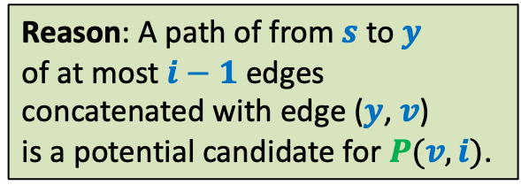
The brilliant idea of Bellman Ford
Recursive Formulation for $L\left(v,i\right)$
Case 1: $P(v,i)$ has $<i$ edges $L(v,i)$ = $L(v, i−1)$
Case 2: $P(v,i)$ has exactly $i$ edges
$L(v,i)$ = $\min_{\left((x,v\right)∈E)}\left(L\left(x, i−1\right)\text{+} ω\left(x,v\right)\right)$
So can we take care of Case 2 now ?
$$i$$
$$i−1$$
$$1$$
Paths with edges $≤i$
Paths with edges$≤i−1$
Reason: A path of from $s$ to $y$
of at most $i−1$ edges
concatenated with edge ($y$, $v$)
is a potential candidate for $P(v,i)$.
$L(v,i)$ $≤{ \left(L\left(y, i−1\right)\text{+} ω\left(y,v\right)\right)}$
$$1$$
$$2$$
$$…$$
$$i$$
$$y$$
$$s$$
$$x$$
$v$

Slide 21


The brilliant idea of Bellman Ford
Recursive Formulation for $L\left(v,i\right)$
Case 1: $P(v,i)$ has $<i$ edges $L(v,i)$ = $L(v, i−1)$
Case 2: $P(v,i)$ has exactly $i$ edges
$L(v,i)$ = $\min_{\left((x,v\right)∈E)}\left(L\left(x, i−1\right)\text{+} ω\left(x,v\right)\right)$
$$i$$
$$i−1$$
But we do not know which one of these 2 cases occurs ?
$$1$$
Paths with edges $≤i$
Paths with edges$≤i−1$
$$\min_{\left((x,v\right)∈E)}\left(L\left(x, i−1\right)\text{+} ω\left(x,v\right)\right)$$
$L[v,i]\text{←}$ min( ? , ? )
$L(v, i−1)$

Slide 22
Homework
1. Go through the slides of this lecture
Very slowly
Very attentively
2. Try to write a neat pseudocode of the final algorithm.

